Slide 1
Data Source: Indeed
Review page and Salary page.
The variables I webscaped are yearly salary, benefit rating, culture rating, management rating, work life balance rating, and overall rating.
I was trying to find out two things
1.Does overall rating has linear relationship with year salary?
2.Does benefit rating, culture rating, management rating, and workbalance rating can have multiple linear relationship with overall rating?

Slide 2
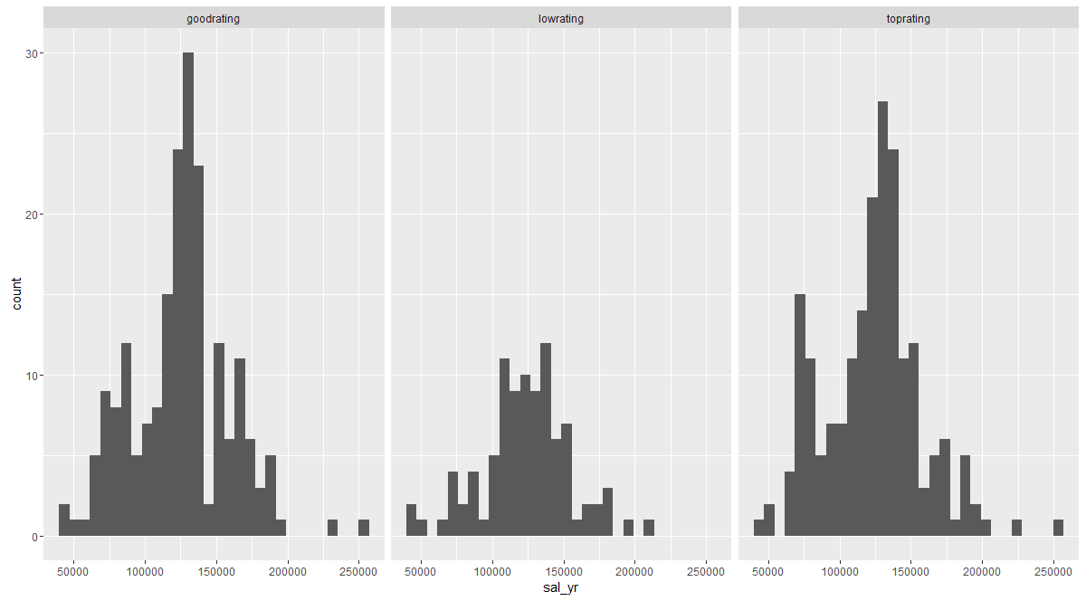
If we separate the overall rating score as top, good and low, can we see the salary difference?

Slide 3
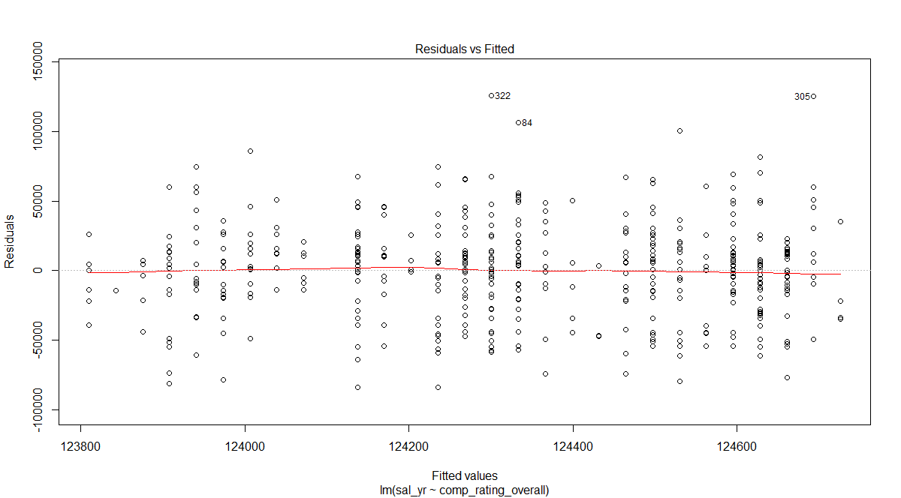

Slide 4
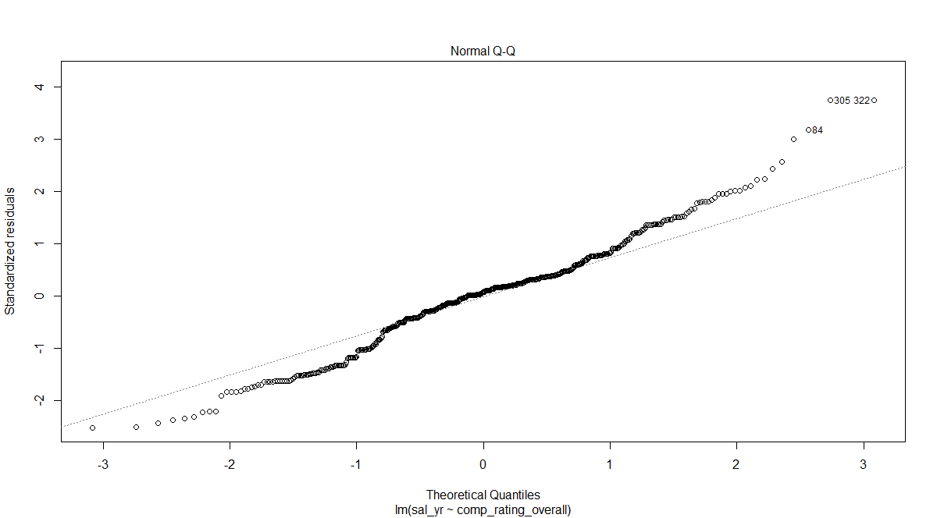

Slide 5
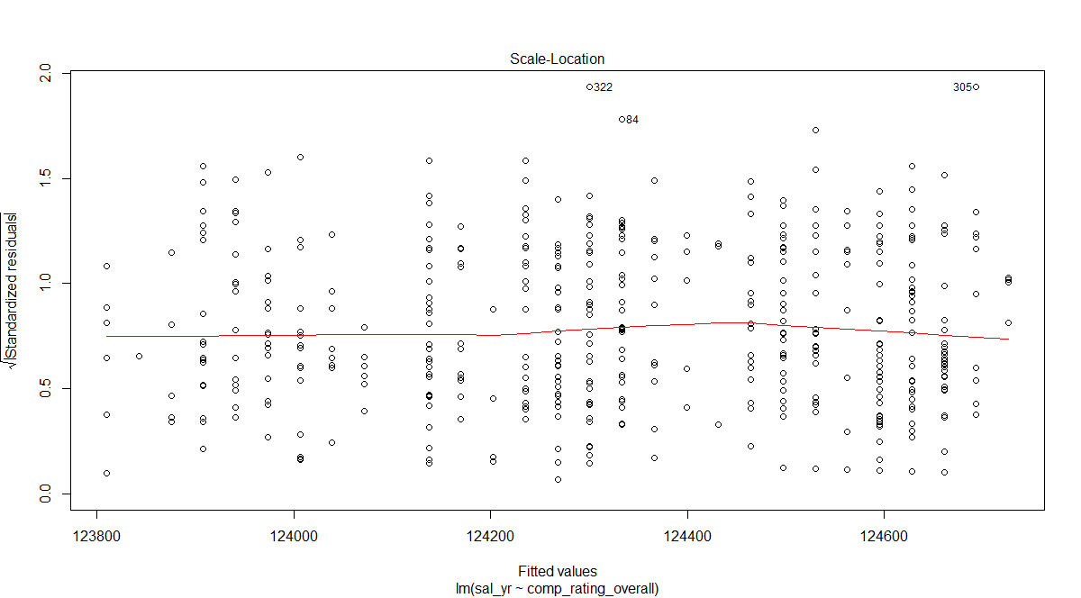

Slide 6
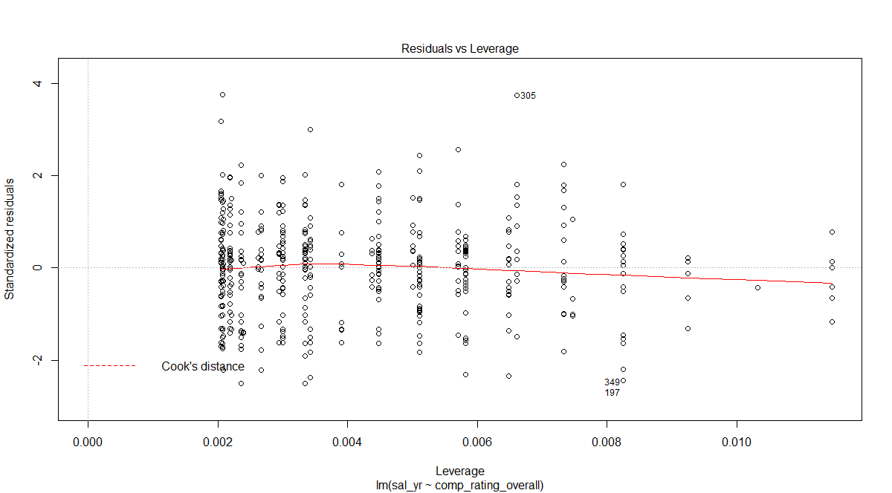

Slide 7
Run linear model and see the summary of this model
P values is as high as 0.873, which is not significant
Adjusted R square is just 0.02

Slide 8
Does benefit rating, culture rating, management rating, and workbalance rating can have multiple linear relationship with overall rating？

Slide 9
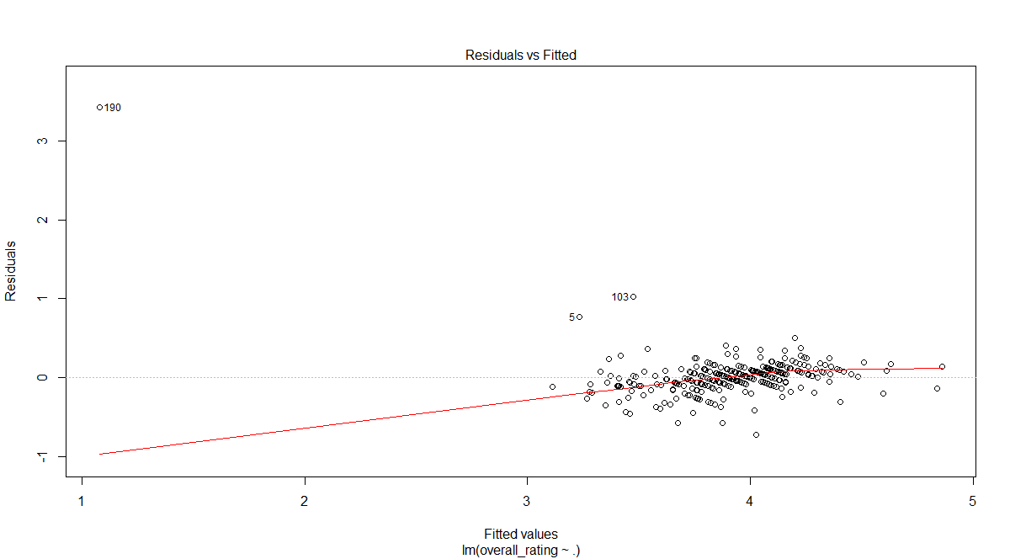
Full Model Assuption

Slide 10
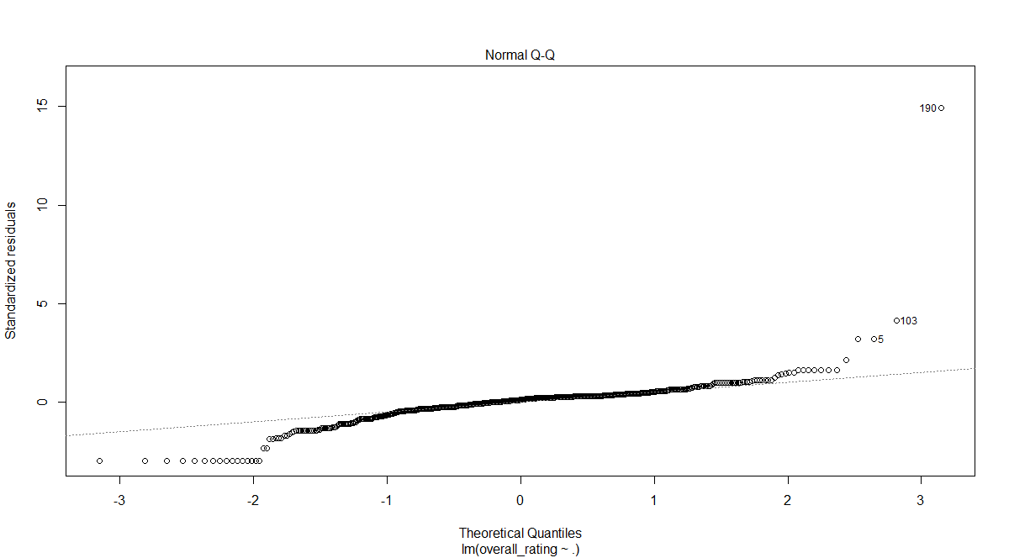
Full Model Assumption

Slide 11
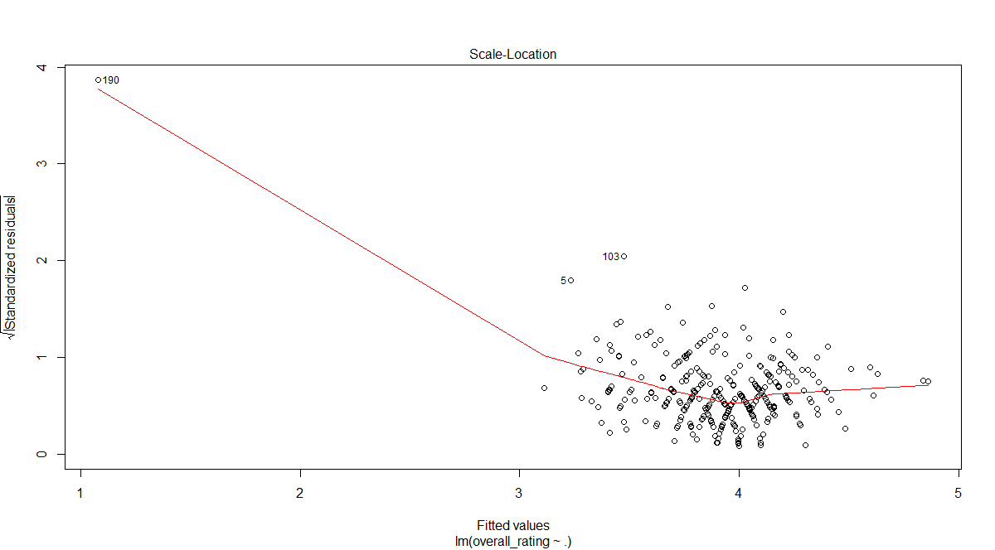
Full Model Assumption

Slide 12
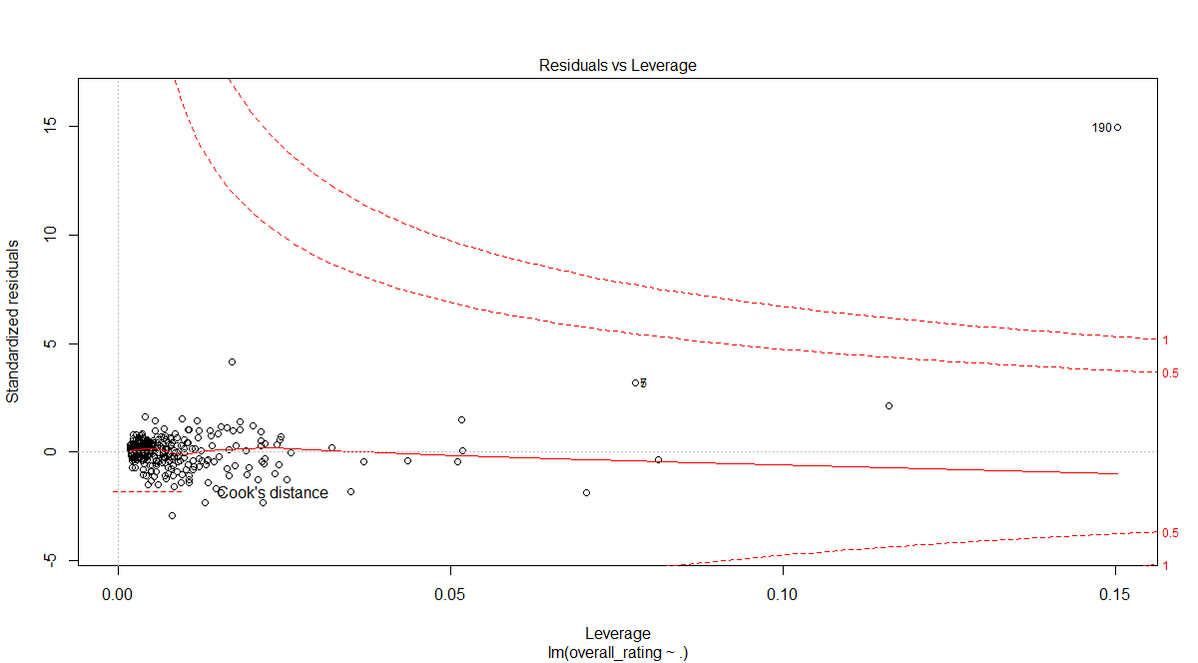
Full Model Assumption

Slide 13
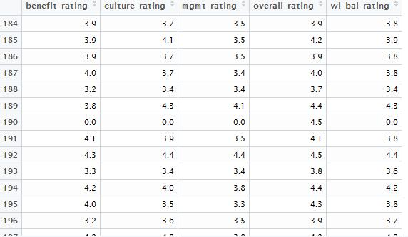

Slide 14
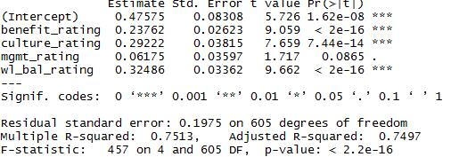

Slide 16
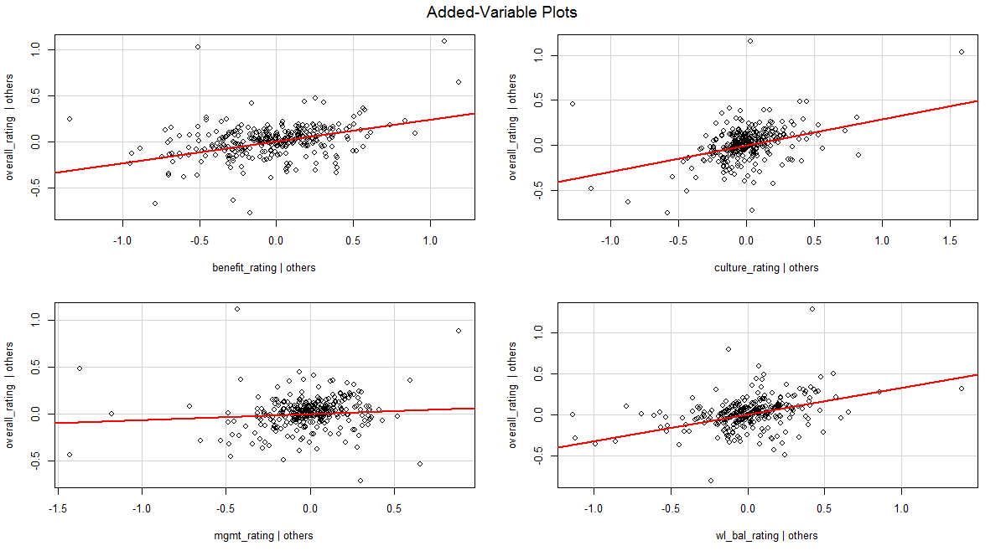

Slide 17
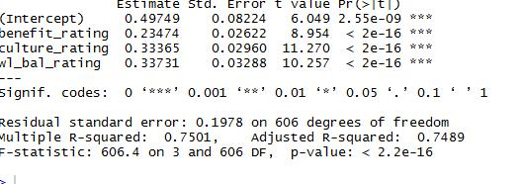
Model3

Slide 18
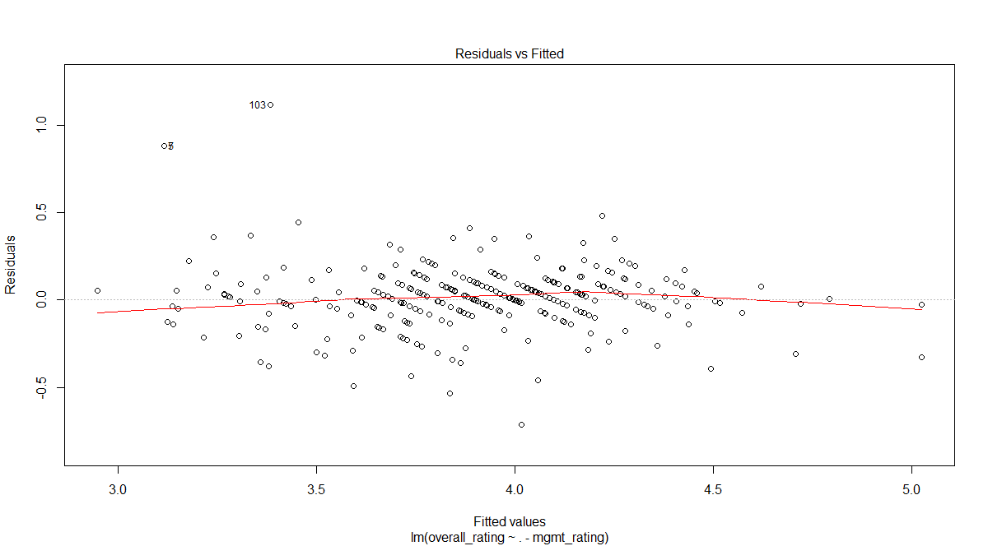
Model3

Slide 19
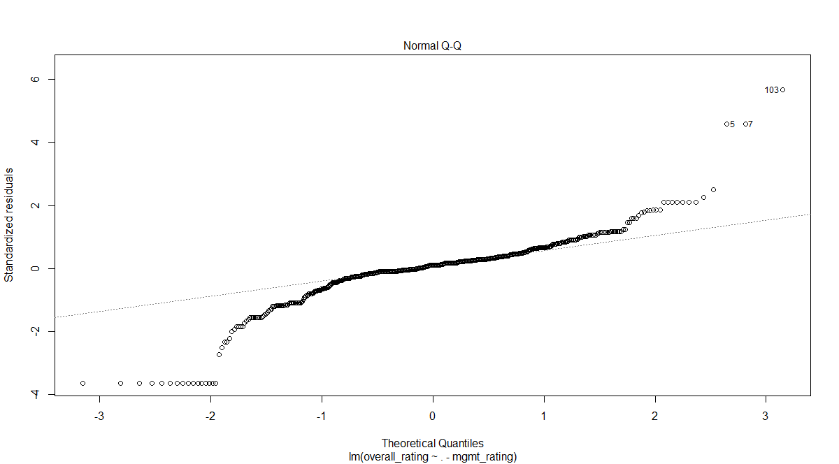
Model3

Slide 20
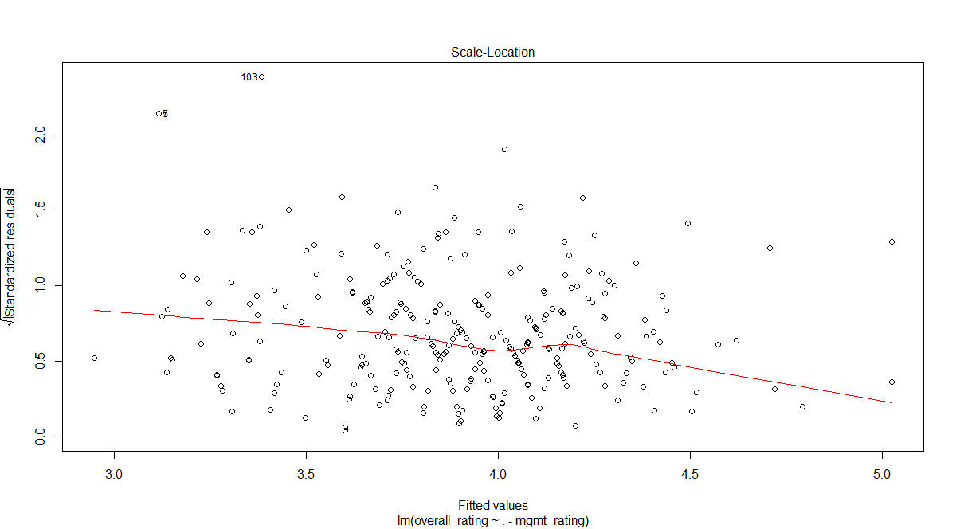
Model3

Slide 21
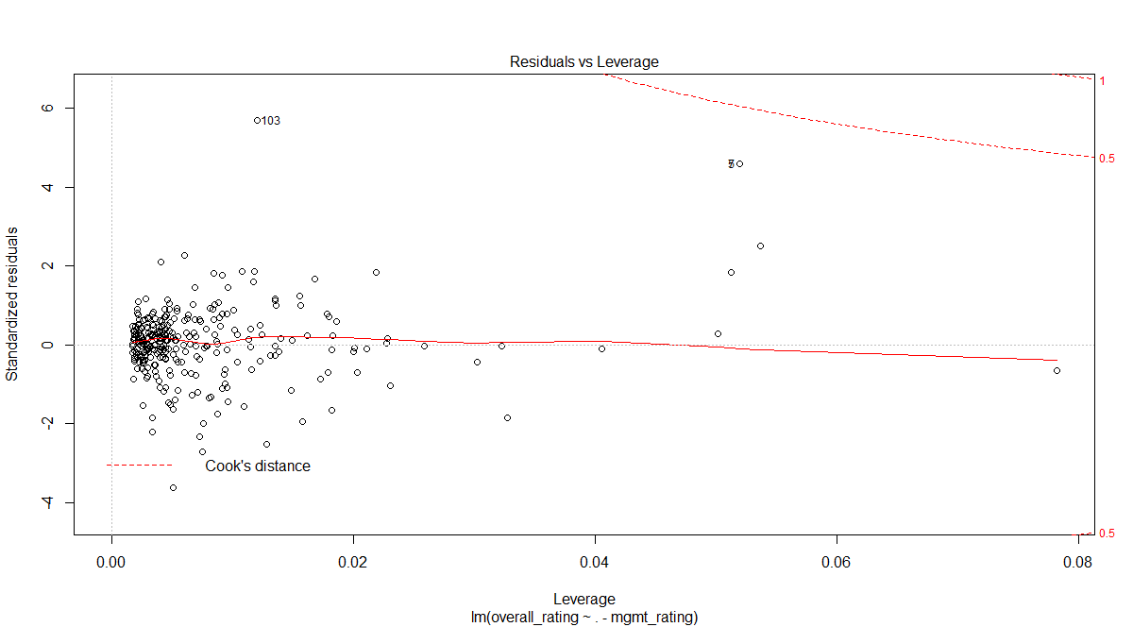
Model3

Slide 22
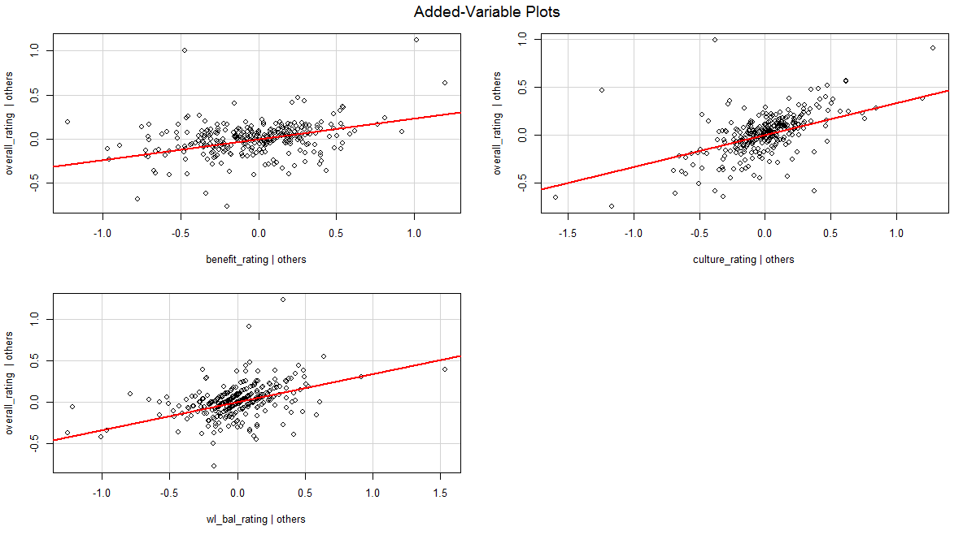
Model3

Slide 23
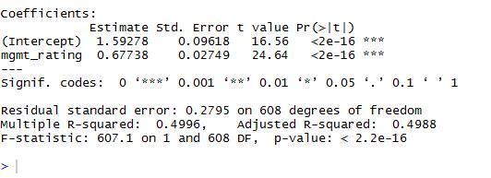
model1

Slide 24
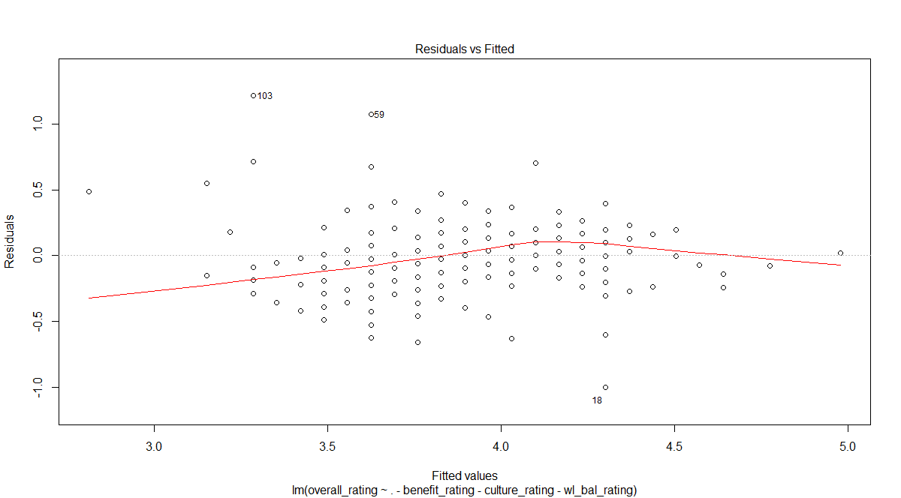
model1

Slide 25
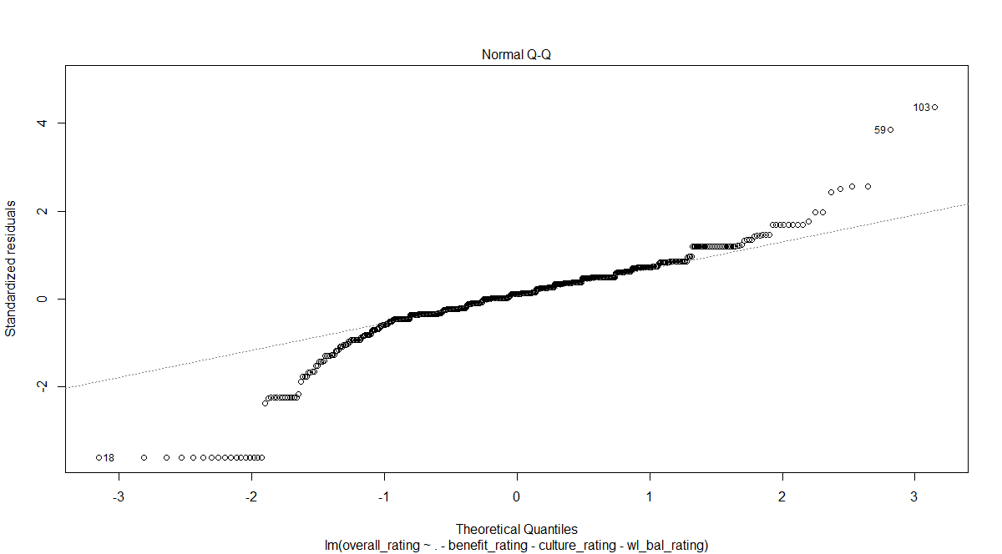
model1

Slide 26
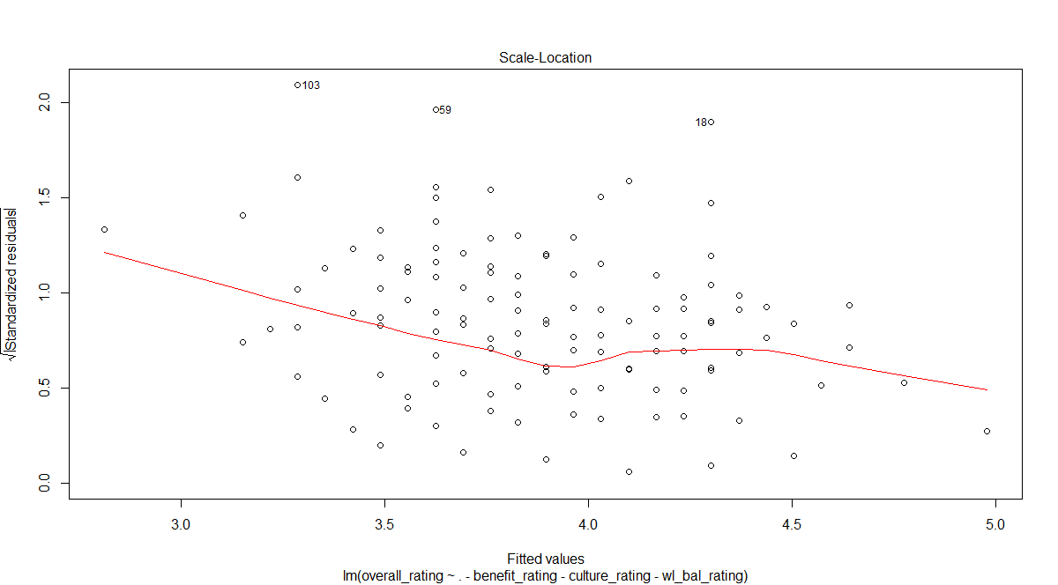
model1

Slide 27
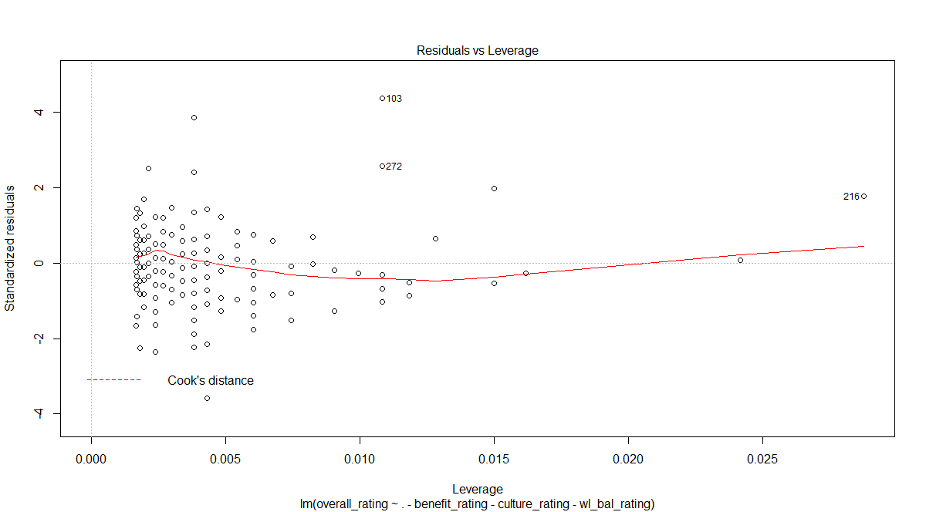
Model1

Slide 28


Slide 29
Overall_rating = 0.23benefit_rating + 0.33culture_rating+0.34wl_bal rating

